Slide 1
Instruction Sets

Slide 2
Where have we been?
We talked about digital logic
We talked about memory
We talked about caches
We talked about the “mechanics” of how the CPU works
Now it’s time to consider how we give the CPU instructions
And how we can measure our CPU performance

Slide 3
Computer Organization Vs Architecture
Computer Architecture – agreed upon interface between a programmer and the hardware designer
Computer Organization – the non-visible (to the assembly language) details
If there are assembly instructions that reference it, it is architecture.
Examples?

Slide 4
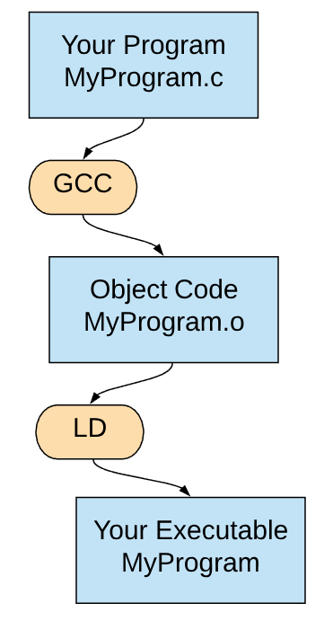
The Whole Stack

Slide 5
Loaders
When you start an application, a program called a loader:
loads the data from disk
performs relocation
jumps to the beginning of your program (the entry point)
relocation: your assembly may have addresses in it. There is an index of where all the addresses are. Relocation changes the addresses to their actual loaded address.

Slide 6
What is an instruction?
A series of bits that the CPU interprets in a known way
In SIA, the first 4 bits are the “opcode” – operation code.
The CPU decides what to do via those 4 bits.
MIPS uses 6 bits (and sometimes more!), all at the beginning (like SIA).
What can we tell about SIA and MIPS from this observation?

Slide 7
x86 is not uniform
opcode can be in any byte from 0-6.
Uniform is good
easy to decode, easy to parallelize
Non-uniform is good
instruction format less restricted, doesn’t waste space, powerful

Slide 8
Tradeoffs – number of bits
Supporting more instructions requires more bits.
It’s only a few bits. Why does that matter?
In SIA, most instructions are 16 bits.
If your memory bus is 64 bits wide, how many instructions can you fetch at once?
Most MIPS instructions are 32 bits. How many instructions can you fetch at once on the same bus?

Slide 9
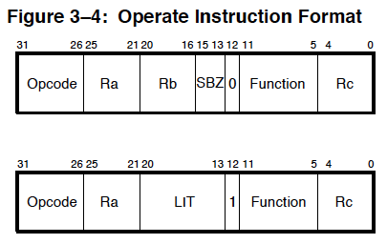
Bit Steering
Bit steering is the term for a single bit “steering” the CPU – controlling how the next bits are interpreted. An example from the Alpha CPU.

Slide 10
Accumulator Architectures
Only one data register – the accumulator (for results of computations)
A small (2) number of address registers.
All data is stored in RAM; you change the address registers, then indicate the instruction to be performed on the two address registers.
Example:
LDA #$c0 ;Load the hex value $c0 into the accumulator
TAX ;Transfer the value in the accumulator to X
INX ;Increment the value in the X register
ADC #$c4 ;Add the hex value $c4 to the accumulator
BRK ;Break - we're done
6502

Slide 11
Stack Based Architectures
No registers at all. The CPU works totally in memory.
Very simple to build a CPU for, small instruction set.
A lot more memory references.
Hard to run out of order, pipeline, etc. Not flexible.
Example:
push 5
push 3
add
push 2
multiply
Mostly implemented in virtual machines – rarely in hardware.

Slide 12
Dataflow Architecture
Instead of thinking of a program as a list of things to do, consider it, instead, as a graph of operations.
The CPU executes instructions when their inputs are available. Order of execution is indeterminate, although constrained by the graph of operations.
This has never been commercially implemented as a general purpose CPU, but there have been examples in, for example, DSPs.

Slide 13
CISC
Complex Instruction Set Computer
The instruction set has lots of complex instructions. VAX was the king of CISC – it had instructions for string operations, like “strlen” and even polynomial evaluation! x86 and x64 are the most popular CISC
Easy and fun to write in assembly with all of these toys to play with!
How do you think that impacts processor performance? Think about clock rate and memory bandwidth.

Slide 14
RISC
Reduced instruction set computer
A reaction to CISC – simplify the instructions, run the clock faster
MIPS and ARM are good examples.
Consider the tradeoffs from the last slide (clock speed, memory bandwidth)

Slide 15
Hybrid CISC-RISC
Store CISC in memory, convert the instructions to RISC inside the CPU
Benefits: Instruction packing in memory, better use of memory bandwidth
Downsides: More circuitry to do the unpacking, CPU is more complex and doesn’t match the ISA model exactly
Who uses this today?

Slide 16
Registers
Recall that SIA has 16 registers
How many bits do you need to represent 16 registers?
Recall that MIPS has 32 registers
How many bits do you need to represent those 32 registers?
Why does this matter?
What do you think about a machine with 256 registers?

Slide 17
Register Use
When we don’t have enough registers, just like cache, we “thrash” – we load/store values to main memory. This slows our code.
If we have “too many” registers, we paid the price (instruction size, SRAM, power) to have all these registers and we aren’t using them.
What’s the right number? Depends on the program that we are running.

Slide 18
R0
In MIPS (and others), R0 is a read only register that always contains the value 0.
Why?

Slide 19
Status Register
There are two approaches that can be used for comparing data:
SIA and MIPS both have compare instructions:
  BEQ R1,R2,100
Other CPUs have a special register, the status register, that is updated by the ALU (but also have a specific instruction to do compares). There are branch instructions (BEQ $1000) that branch based on the contents of the status registers.
What are the tradeoffs?

Slide 20
Status Register Tradeoffs
Many instructions need to update the status register (more work/op)
Programmers need to track which instructions can change which bits in the status register (hard to code for)
Conditional branches have more bits for address
*IF* the branch condition comes from some other math op, status registers might save effort. If not, the operation will take 2 instructions, compare, then branch

Slide 21
Addressing Modes
An addressing mode is the description of what happens to an operand when the instruction processes. In higher level programming languages, these changes are separate steps.
In C, I might say:
*(s+1)=0;
I would describe that as three steps:
Add 1 to s
Dereference s
Assign that address the value 0.
In assembly, that might be a single operation:
MOV 1(%s),#0

Slide 22
Addressing Modes (x86)
CISC, being an “assembly first” language, tends to have lots of interesting addressing modes.
In x86, a memory location can be specified by:
a constant
a register (which contains a pointer)
a register + a constant
the sum of 2 registers
the sum of 2 registers with one being multiplied by 2,4,8
the sum of 2 registers with one being multiplied by 2,4,8, + a constant
conditional branches are offsets from the current instruction

Slide 23
Other CISC addressing modes
Autoincrement/Autodecrement
A register points to memory.
Get the value from that memory address, then increment/decrement the value in the register
Memory indirect (char **ppChar)
The specified register points to memory
Use the value stored in that memory to as a pointer to the value we want.

Slide 24
Addressing Modes (MIPS)
Accessing memory can only be done via the load and store instructions which use “register + constant”.
Jump is an absolute address
Branches specify offsets to the current program counter
RISC tends to have fewer addressing modes

Slide 25
Orthogonality
Remember this from ICSI311?
How often can every addressing mode be used with every instruction?
Pros – easier for the programmer and hardware designer
Cons – space/memory bandwidth
Operands “have to” be distinct from operation bits

Slide 26
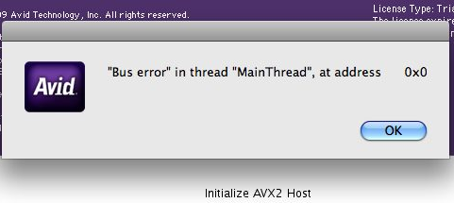
Alignment
Some CPUs require instructions and/or data to be aligned.
A 4 byte alignment means that any address that is fetched mod 4 == 0.
Why?
Performance, Simplification
Also, if we know that a word has to be 4 byte aligned, we can leave the bottom 2 bits off of the address in the instruction.
Why?

Slide 27
Load/Store vs Memory-Memory
Most RISCs are Load/Store – memory → registers, operations happen, registers → memory
Most CISCs have registers but can also operate on memory directly
What are the tradeoffs?

Slide 28
Variable Vs Fixed Width Instructions
Most RISC designs have fixed width (32 bit is most common) encodings
Most CISC designs have variable width instructions
What are the tradeoffs?

Slide 29
Fixed Width
Variable Width
All instructions are constant size
Branches can be calculated easily
All fetches are aligned – no shifts
Easier to implement hardware
Easier to decode in parallel
Less wasted space
Fewer compromises
More flexible
More future proof
Can Huffman encode

Slide 30
Alternate Encodings
Sometimes, in CISC designs, a particular instruction is used SO frequently, it makes sense to have an “alias” – a shorter encoding of the same instruction.
For example –
add eax, constant
normally, you have to encode the addressing mode for each operand.
If you instead use opcode 5, you don’t need to specify addressing mode – just the 5 then then constant.

Slide 31
Data Types
While CPUs don’t have data type protection like a compiler, the operations that a CPU can execute have to follow the rules for the data type.
Examples:
integer, floating point, character, BCD
Some CPUs have instructions for strings, lists, queues

Slide 32
Semantic Gap
The difference between what the software people are trying to do and what the hardware people have built into the hardware.
For example – if there is no hardware support for bytes, that is a semantic gap.
This is part of the tradeoff between implementing at the CPU level and in software.

Slide 33
Complex Instructions
If an ISA supports complex instructions:
Fewer instructions are needed
  Better for memory/cache
Simpler Compiler
  Better mapping between high level language and CPU
Burden of backward compatibility
How often is this instruction actually used?

Slide 34
Simple Instructions
If an ISA supports only simple instructions:
Simpler chip design
Fewer bugs
Easier to clock faster/pipeline more/Reorder instructions
Assembly Programmer/Compiler has to do a lot more work
More memory accesses (because the instructions do less)

Slide 35
How Can We Have It All?
What if we had a CISC, with all of the benefits of a complex instruction set, but ran it on a RISC CPU and got all of the benefits of a fast RISC implementation?
How?
Translate CISC instructions into RISC instructions just before we execute them!

Slide 36
Finished!
Intel and AMD have been doing this for CENTURIES (2)
The actual CPU code doesn’t speak x86 or x64 at all.
There is a hardware translator that converts a CISC instruction to one or more instructions that run on the RISC core.
This is why RISC has not surpassed x86 in performance – RISC has the disadvantages of RISC and none of the benefits of CISC. x86 has (mostly) only the benefits. There is a HW/heat cost of translation, but it is very reasonable compared to the benefits.

Slide 37
Microcode
This process is called microcode.
One interesting note – the mapping from CISC to RISC is stored in the CPU in memory that CAN BE updated.
Both AMD and Intel will occasionally update their microcode. Sometimes this is used to fix security issues, sometimes to fix bugs.

Slide 38

Big Endian vs Little Endian
In Gulliver’s Travels, there are two islands – Lilliput and Blefuscu. On one island (Blefuscu), they break their hard boiled eggs on the “big end.” The other island breaks their eggs on the small end.

Slide 39
How Do We Write Numbers?
In Arabic numbers, we write the most significant digits on the left.
123,456 ← 1 is the most significant
This is a big endian arrangement.
If you wanted to store 0x1234:
Endian | Address 0 | Address 1
Little | 0x34 | 0x12
Big | 0x12 | 0x34

Slide 40
Why?
Little endian, while being counterintuitive, has a couple of advantages:
I can tell if a number is even or odd from looking only at the first byte
Multi-precision math (i.e. adding a 16 bit to a 32) is easier to write
Intel picked it
Big Endian:
Intuitive
I can tell if a number is positive or negative by looking at the first byte (why?)
Binary to decimal is easy to write

Slide 41

And why does this matter?
Assemblers and compilers handle this for you. If you are writing one of those, you should know which the CPU needs.
Data interchange – if I store, for example, an IPV4 address as int32 on a little endian and I send that to a big endian computer, I will have a bad time…
Work arounds?
Create a standard (always big or little) for interchange.
Use a flag indicating which the following address is.
Write everything to text.

Slide 42
Instruction Classes
Operation Instructions
Process data, ALU
Data Movement
MOVE, IN, OUT – copies data between registers, RAM, I/O
Control Flow Operations
JUMP, Bcc, CALL

Slide 43
How to decide what instructions go in your ISA
First, are you starting from a truly blank slate?
Do you need to be backward compatible with something?
Has this been done before? Can we stand on the shoulders of giants?
Consider the work that needs to be done (high level)
Is this a purpose built chip or “generic”?
Purpose built chips (embedded, for example) can be very specific

Slide 44
This is an art…
There is no algorithm, no book, no step by step plan
The best thing that we know is to build it (simulation) and test it.
There are some general ideas and guidelines, though…

Slide 45
Measure twice, cut once
Chose a body of software that represents the kinds of applications you think will be run on your CPU
Probably not “League of Legends” – smaller, more self contained tests. SPEC92, for example.
Either build a compiler back end OR hand-code the application in your assembly language, then test it on your simulator
This is MUCH easier if you are modifying an existing architecture

Slide 46
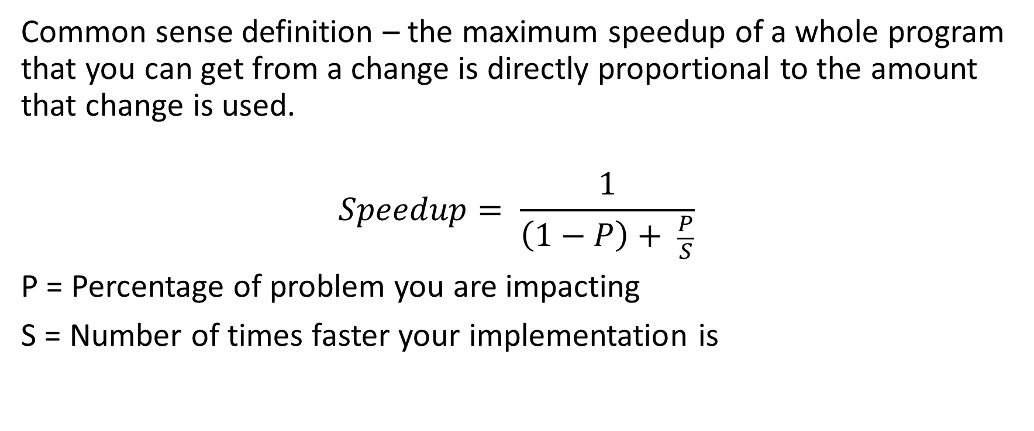
Amdahl's law
Common sense definition – the maximum speedup of a whole program that you can get from a change is directly proportional to the amount that change is used.
$$Speedup= \frac{1}{\left(1−P\right)+ \frac{P}{S}}$$
P = Percentage of problem you are impacting
S = Number of times faster your implementation is

Slide 47
Amdahl's law example
You are considering adding a “strlen” function to your CPU.
You have measured that you can make strlen 4 times faster by doing it inside the CPU and that strlen is about 10% of the runtime of your example code.
Speedup = 1/(1-.10) + (.1/4) = 1/(.9 + .025) = 1/.925 = 8% speedup
Hint – the speedup is FAR less important than the frequency of use

Slide 48
Amdahl’s Law and Parallelism
This same law applies to making your code run in parallel
If your code has some code that can NOT be parallelized (startup, accessing common resources), the P will be the percentage of code that CAN be parallelized and the speedup will be the number of threads you can use.
Keep in mind – Amdahl’s is theoretical MAXIMUM. It’s not a guarantee of that number. Only testing will give you that.

Slide 49
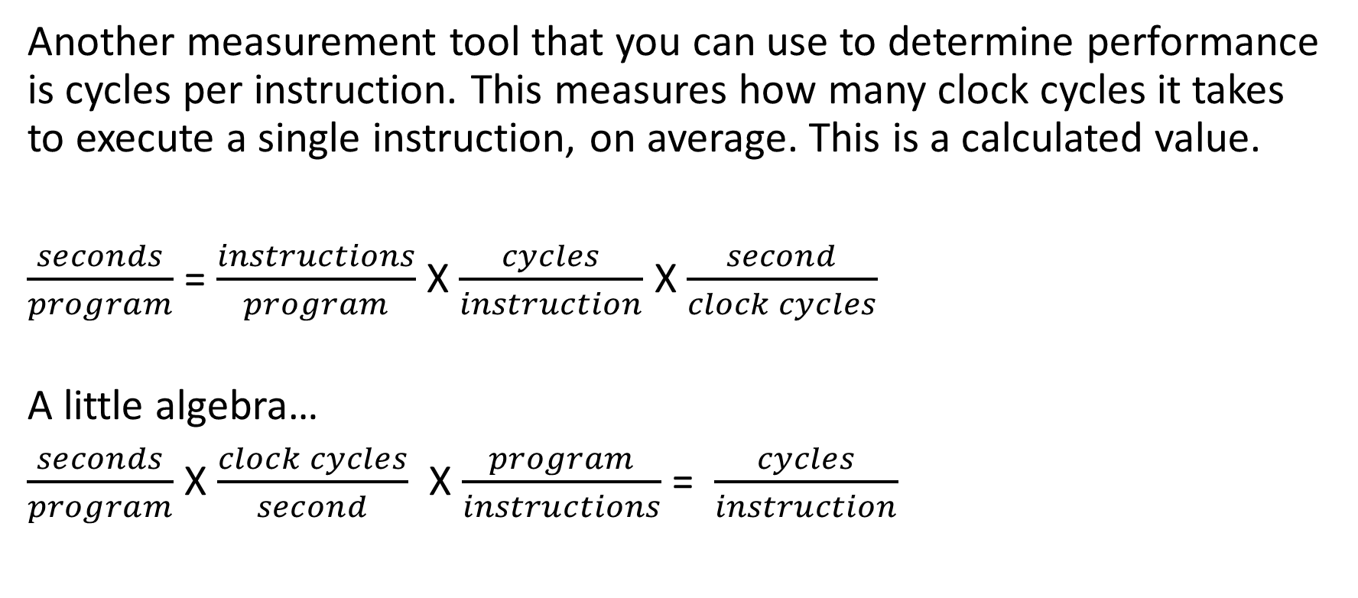
CPI
Another measurement tool that you can use to determine performance is cycles per instruction. This measures how many clock cycles it takes to execute a single instruction, on average. This is a calculated value.
$\frac{seconds}{program}$ = $\frac{instructions}{program}$ X $\frac{cycles}{instruction}$ X $\frac{second}{clock cycles}$
A little algebra…
$\frac{seconds}{program}$ X $\frac{clock cycles}{second}$ X $\frac{program}{instructions}$= $\frac{cycles}{instruction}$

Slide 50
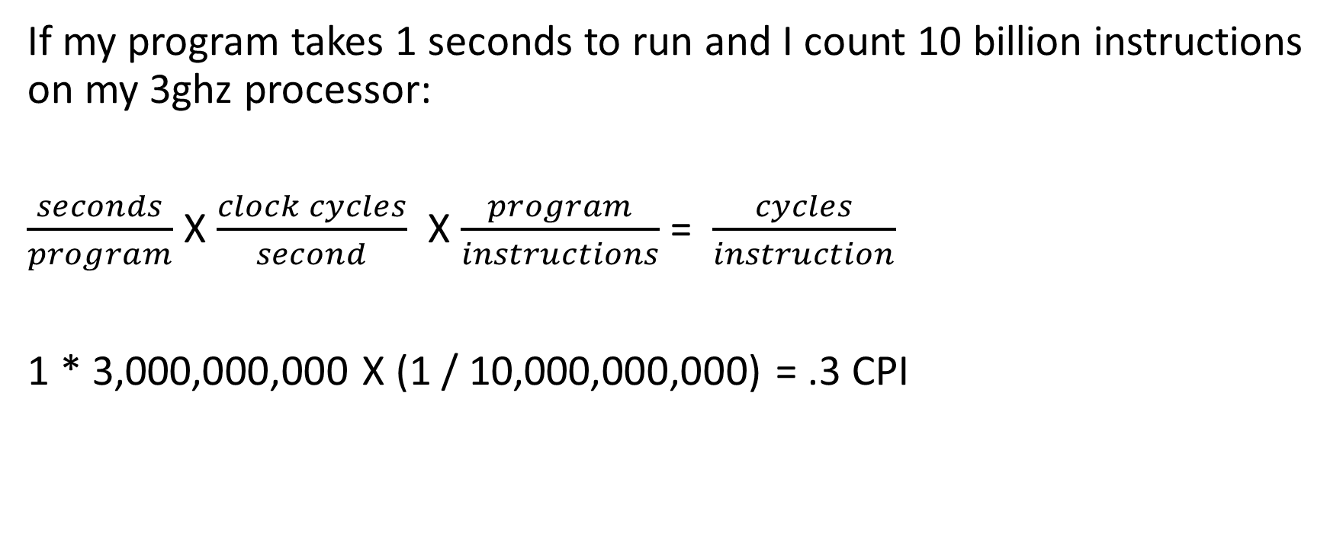
CPI Example
If my program takes 1 seconds to run and I count 10 billion instructions on my 3ghz processor:
$\frac{seconds}{program}$ X $\frac{clock cycles}{second}$ X $\frac{program}{instructions}$= $\frac{cycles}{instruction}$
1 * 3,000,000,000 X (1 / 10,000,000,000) = .3 CPI

Slide 51
Wait a second…
You are right – that doesn’t take a LOT into account – it is sort of a finished product measure.
This measures performance of cache, memory, CPU, operating system, compiler, optimizer, timer accuracy, everything.
How can we make that better?

Slide 52
Getting an accurate CPI
Run your code a lot of times in a tight loop. This negates the effect of memory fetches, since your code will always (except the first time) be in cache.
Make sure that your test takes a while (increase your loop size). This negates timer inaccuracy and reduces operating system overhead.
Unless you are explicitly trying to test memory, make your code small and simple enough to run in a register.
Look at the output from the compiler. Is the instruction that you are trying to test even in there? Did it get optimized out? Consider writing the loop code in assembly.
Make sure that there are no function calls at all in your loop. The overhead of calling and returning will undercut your accuracy.

Slide 53
What’s it good for?
CPI can only be used within an ISA. CPI measures between, say, x86 and MIPS are useless because an instruction is not constant.
But, you could use it to compare different models of the same processor (say, AMD and Intel x86’s).
It might be interesting to compare two different RISC machines using CPI *IF* the instruction set was very close.

Slide 54

The shield is still up!
All of the above will lead you into doing what has already been done.
Why?
Compiler back ends are designed for an instruction set. Instruction sets are designed to go faster based on what the compiler outputs.

Slide 55
So what do you do?
Build it all
Recognize that an existing compiler (and maybe an existing language!) won’t conform to your ideas
Build a new architecture, compiler, language (maybe)
…
Profit?
Give up
EASY!
No one will fault you
There is still lots of software to write and work to do…

Slide 56
Hardware Interaction
x86 uses “hardware ports”, with IN and OUT opcodes
the portions of the system that are unchanged from the 1980’s use this: timers, interrupt controllers
but some more modern hardware has hardware ports as well as mapped memory
memory mapping – assign a range of memory that is routed to hardware
All of the newer components are mapped into memory
This memory mapping is “just” for control registers

Slide 57
A (very) bad design for I/O
Let’s assume that we are designing a disk controller.
We have a read register. We write a value into that register indicating which word on the disk we want to read.
The CPU then looks every so often at a status register. When the status register indicates the read is complete, the CPU then copies that word into memory somewhere and writes the next address to the read register.
Why is this a bad design?

Slide 58
Interrupt Processing
All CPUs have a mechanism to interrupt normal processing. When one or more of the interrupt pins are raised (current is passed through them), the CPU finishes the current instruction, then jumps to an interrupt handler.
Some CPUs just have a single interrupt pin. When they are interrupted, they have to poll each device to see if that device interrupted them. These are called polled interrupts. It is an idea that has (thankfully) been replaced.

Slide 59
Vectored Interrupts
The CPU has some number of pins/lines that define an interrupt. On x86, there are 8 interrupt lines (how many interrupts are possible?).
An array of “slots” exist that the operating system must manage. When an interrupt occurs, the “slot” corresponding to the interrupt is used to determine the address of the code to process the interrupt.
Most interrupts can be defined by the operating system and invoked by the INT instruction. Others (like divide by zero and control-alt-delete) are system defined.

Slide 60
A bad design for I/O
Let’s assume that we are designing a disk controller.
We have a read register ($0). We write a value into that register indicating which word on the disk we want to read.
When that word has been read, an interrupt happens. The CPU then copies that word into memory somewhere and writes the next address to the read register.
Why is this a bad design?

Slide 61

DMA – Direct Memory Access
Instead of the device writing a word into a memory mapped area, then having the CPU copy the data into other memory, it would free the CPU up if it didn’t have to copy the memory around.
A tiny co-processor, called a DMA controller, does this work. The DMA controller is set up as another peripheral using hardware ports.
The device driver (software) tells the DMA co-processor to manage the process and it does. When the process is complete, an interrupt occurs and the transfer is complete.

Slide 62
A Note About Performance…
DMA is wonderful, because it frees the CPU from copying byte by byte or word for word
However, it does need to write to memory. Which, as we remember, is a resource that is always under pressure.

Slide 63
Calling Conventions
CPUs don’t (usually) have any enforced rules about how to call a function. They sometimes have instructions to assist, though.
For example – x86 has a “call” and a “ret” instruction. Call pushes the current Instruction Pointer onto the stack and jump to the parameter. Ret pops the IP off of the stack into the register.
MIPS’ “link” instructions put the return address in a register. JR jumps to the address in a register, which can be used as “ret”
What if one MIPS function calls another function?

Slide 64
Register Spilling
When a function calls another function, the registers must be written into memory so that the data is not lost.
There are a few approaches:
Caller writes the registers. (it knows what has data)
Callee writes the registers. (it knows what it will overwrite)
Split the difference – define some set of registers each is responsible for.

Slide 65
Stack ‘em up!
Another approach is to give up on registers.
Push all of the parameters onto the stack.
The callee can then use stack relative references to access the parameter data.
Clean up is as easy as moving the stack pointer.
x86 uses a number of different approaches – fastcall (registers, then stack), cdecl (stack), many more

Slide 66
Operating Systems
So far, we have talked about the CPU without regard to the operating system.
The operating system’s job is
Resource Management
To provide an abstract platform for software to run on

Slide 67
Resource Management
When we run an application, it gets a pool of memory to work with (the heap and the stack). What would happen if that pool of memory overlapped with someone else’s memory?
Likewise, all of the hardware in the system is managed by the operating system – keyboard, mouse, display(s), everything.
In order to protect those resources, there has to be a way to ensure that some software has more rights than other software.

Slide 68
Kernel Mode
Called Ring 0 on x86
Can access all memory
Has access to all I/O
Can perform other, CPU specific tasks (examples – switch 32/64 bit mode, on some processors you can switch big and little endian).
Some CPUs have instructions that only run in Kernel Mode

Slide 69
Task Switching
Although our CPUs have multiple cores today, the CPU doesn’t do one thing continually until it is finished.
Why?
1) Waiting for I/O, timers, other applications would be wasteful
2) To “be fair” to all of the tasks that need to be done

Slide 70
Task Switching
A timer is set from kernel mode
The kernel “jumps to” user mode
One of two things happen:
1) The timer expires, causing an interrupt
2) The user software calls (some) kernel function (say, load a file)
The kernel stores all registers, including the instruction pointer, to an area in memory the OS manages for this process.
Another process is chosen, its registers are copied out of the area in memory for this process, then (jump to top of slide)

Slide 71
Debugging Support
The processor “must” provide support for debuggers. There is no other way for a debugger to be able to walk through the code.
MIPS provides a “SDBBP” instruction that causes a debug interrupt. A debugger can insert these into a program before it runs. This corresponds to a breakpoint in the debugger. The operating system, when this break point occurs, can gather information from the registers and make the debugger the current process.

Slide 72
Debugging Support – Single Step
When you step through a program, every instruction executed in the target program causes a debug interrupt.
There is a significant performance loss from running in single step.

Slide 73
Virtual Memory
In the (recent) past, people needed more memory than they could afford or even fit in a single PC.
The best solution (there were others) to this solution was to consider memory in pages (say, 4k each). Insert a layer of hardware in the memory controller that maps a “virtual” address to a physical address. When a virtual memory access occurs, one of 3 things happens

Slide 74
Virtual Memory
The virtual address maps to a real address. In that case, the top 20 (why?) address bits are changed and the memory controller lets the request happen.
The virtual address has no real address. In this case, an interrupt (PAGE FAULT) occurs. The operating system finds 4k of real memory, “fixes” the mapping file, loads data from disk into that 4k, then continues the process.
The virtual address is not valid (for this process). This is caught in the page fault and the process is killed (usually).

Slide 75
Writing Memory to Disk
In the last slide, we mentioned that the OS loads the contents of the memory from disk. How did it get there? When the OS needs RAM, it can write a page to disk, mark the page as unmapped, then add the page to the free memory list.
Isn’t this slow?
Yes. The alternative, though, is to run out of memory or have the OS start killing processes.

Slide 76
Why do we care about Virtual Memory
It’s not “useful” anymore, right? Well, for the most part, no.
The still interesting aspect is that the virtual memory system does other things.
One aspect is memory access control.
Another is mmap.

Slide 77
Memory Access Control
In the “old days”, any program could read/write to any memory address. This worked reasonably well when you ran one program at a time. Multi-tasking and multi-user systems made this freedom infeasible; a bad pointer can cause illicit reads or writes through other applications.
With virtual memory, an application can only read or write from memory that is assigned to them.

Slide 78
mmap
Assume, for a moment, that you had to search a 1TB file. The search is context sensitive and you have to compare a bunch of lines to each other.
You could make some buffering system where you load lines and store them in a rotating list of buffer strings. That’s ugly and hard.
The operating system has “mmap” – map a memory region to a file. This works using the vm system, so it is really fast to set up and use.
void *mmap(void *addr, size_t length, int prot, int flags, int fd, off_t offset);
prot : EXEC|READ|WRITE|NONE, flags: SHARED, PRIVATE, FIXED

Slide 79
Segmentation
Before paging became popular on PCs (before hard drives to page to/from), there was another mechanism for memory protection – segmentation. This is no longer a common architecture outside of x86. segmentation is (mostly) disabled in x64.
There are a series of segment registers – code, data, stack and 3 additional (ES, FS, GS). These point to segment descriptors – a small area of memory that holds a base address, a limit and access controls.
The base address and limit give a memory range. Code, data and stack accesses are automatically checked to ensure that they are within the segment. If not, an interrupt occurs. When specifying an address, you can specify the segment.

Slide 80
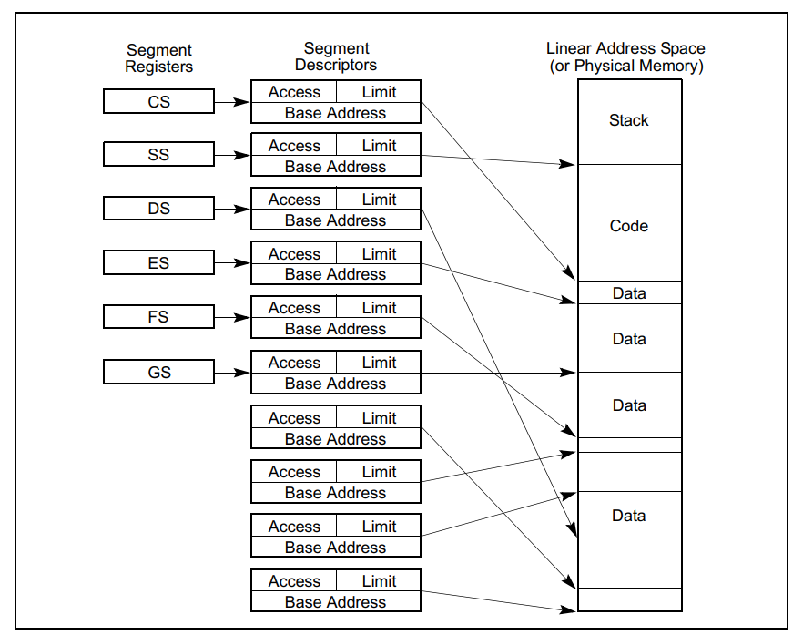

Slide 81
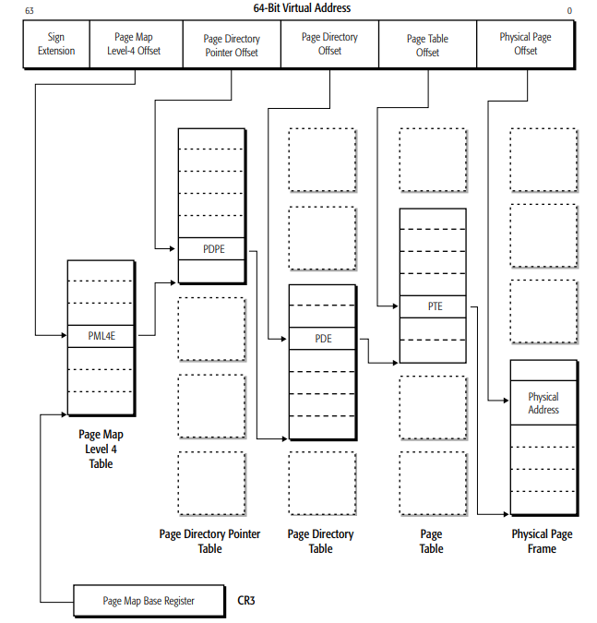
x64 paging
3 possible page sizes: 4k, 2mb, 1gb. There are 4 layers. The 64 bit address is broken into 5 offsets.
All addresses start from the Page Map Level 4 table.
The general algorithm is:
given a currently selected table, use the offset as an index into the table
that entry will point to the next table
goto 1 unless this is the page table offset table
We now have a physical address (with the offset).
Notice that a single memory access could require 5 memory accesses.

Slide 82
Wait – isn’t that an infinite loop?
No – the paging tables are in physical, not virtual memory.
Isn’t this outstandingly SLOW?
It would be, except that the memory controller has TLBs – translation lookaside buffers. These cache the mapping from a virtual address to a physical address. These are flushed every time CR3 changes.
When might CR3 change?

Slide 83
What else is in the page table entry?
Present – is this page present in memory?
Is Page Read Only?
Is this page kernel only?
Is this page write-through or write-back?
Is this page cacheable?
Has this page ever been accessed?
Is this page dirty (has been written to)
Is this page executable (contains code)?

Slide 84
MIPS virtual memory (easier!)
A MIPS TLB (page table entry) contains:
Page Mask: Indicates the page size by choosing bits that must match VPN
VPN/2: Virtual address/2 (each TLB maps 2 pages)
Global Bit: Does this apply to every process
Address Space ID: If not global, the id of the process that this applies to
2 Physical page numbers (1 page for VPN, 1 page for VPN+1)
Cache coherency : Cacheable, uncached
Dirty: Is this page dirty/writable?
Valid: Is this page valid?

Slide 85
More MIPS VM
PTE sizes: 4k, 16k, 64k, 256k, 1mb, 4mb, 16mb, 64mb, 256mb
There is a register (EntryHi) that holds the current ASID. The OS needs to change it when processes change.
Interrupts: Non-word-aligned memory reference
TLBRefill – no mapping for the requested address
TLBInvalid – mapping has “valid” off
TLBModified – valid mapping, but

Slide 86
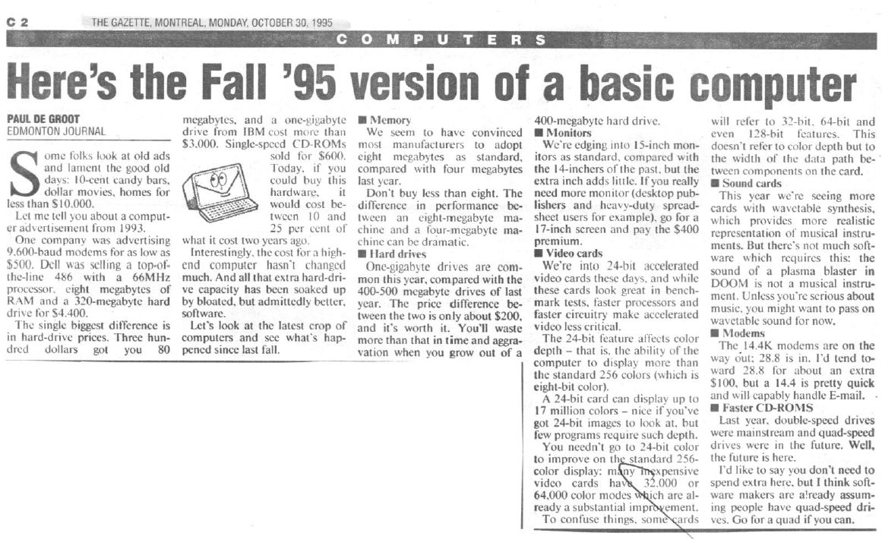
The 90’s were a crazy time…
$1,000 in 1995 == 1,653 in 2018

Slide 87
Multimedia
Multimedia was THE THING in the mid 90’s.
Remember, the internet was SLOW. Transferring “big” amounts of data was CDs or sneaker net.
CPUs were just becoming superscalar and pipelining was new (on the desktop).
DOOM (the first one!) was new and “everyone” wanted videos and games on their PCs. The 100mhz chips of the day couldn’t keep up.

Slide 88
MMX and 3DNow
Intel (MMX, 1997) and AMD (3DNow, 1998) reacted to this by adding new CPU instructions.
Most of the instructions that we have dealt with so far have been SISD – a single instruction works on a single data item (a=b+c)
These are SIMD – single instruction, multiple data
One instructions, can perform the same operation on a range of data

Slide 89
Flynn’s Taxonomy
SISD – single instruction, single data item - classic processors
SIMD – single instruction multiple data – used in GPUs
MISD – multiple instructions operating on the same data (fault tolerance)
MIMD - multiple instructions, multiple data - multi-core super scalar, distributed systems

Slide 90
MMX Example
Imagine you have a person in front of a green screen and a scene you want to insert the person into(called chroma key).
This can be done in a few steps:
Generate a bitmap that is a perfect green screen
Use PCMEQ (packed compare for equality) on the person and green screen to get a mask (the shadow) of the person
Use PANDN (packed NAND) on the original image and the mask to get the person without the green screen
Use PAND on the mask and the scene to get the scene with the shadow “missing” (white where the person will go).
Use POR on #3 and #4 to get the scene with the person in the scene.

Slide 91
How does this work?
MMX introduces 8 new 64 bit registers (remember, many people were running 16 bit mode, some 32 bit mode). MM0-MM7 are the same SRAM as the floating point registers; there is a mode for FP math and one for MMX.
Each instruction operand can be either a register or a memory location.
The operands are packed – if a data source is an array of bytes, MMX considers 64 bits as a package of 8 bytes.
One operation can work on 8 (byte), 4 (word), 2 (longword) or 1 (quadword) data items at a time.

Slide 92
How well did this work?
Title | Speed-up
Audio
Audio Echo Effects | 5.9x
G.728 Code Book Search | 2.7x
DSP Kernels
Efficient Vector/Matrix Multiply Routine | 14.6x
Matrix Transpose | 2x
Dot Product - 16x16 -> 32 | 5x
Real FIR - 16 bit | 5x
Vector Arithmetic and Logic Operations | 6x
Graphics (2D)
Fractals with MMX Technology | 1.5x
Graphics (3D)
Advanced Procedural Texturing | 10x
3D Bilinear Texture Mapping | 7x
3D Transform | 3.1x
Image Processing
2X 8-bit Image Scaling | 13.5x
Bilinear Interpolation | 3.9x
Median Filter | 3.8x
Alpha Blending | 8x
RGB -> YUV | > 10x
Speech Recognition
Viterbi Decoding | 2x
L1 Distance Measure | 3.3x
L2 Norm Distance Measure | 7.3x
Video
IDCT 2D 8x8 | 3.5x
Absolute Difference | 5x
Haar Transform - 2x2 | 2.2x
Get Bits | 2.4x
Video Loop Filter | 1.9
These are Intel’s numbers – your mileage may vary…

Slide 93
SSE (Streaming SIMD Extenstions)
MMX was a good idea. SSE was the next generation (1999).
MM0 – MM7 were extended to 128 bit XMM0 – XMM7
Same idea – 16 bytes, 8 words, 4 long words, 2 quadwords
These registers are DIFFERENT from the FP registers. They have to be load/stored on task swap.
New instructions were added to control caching – looping over a lot of data typically pollutes the cache.

Slide 94
SSE2, SSE3, SSE4
SSE2 (2000) added the instructions from MMX to SSE. This frees the FP registers to be “just” FP registers, since developers should no longer write MMX instructions, but their SSE counterparts.
SSE3 (2004) adds the ability to add within a “package”
  In MMX, SSE, SSE2, you might have a1=a1+b1, a2=a2+b2
  In SSE3, you can now do: a1=a1+a2, a2=b1+b2
SSE4 (2006) adds a number of instructions requested by developers. No significant architectural change.

Slide 95
AVX, AVX2, AVX512
AVX (2011) – the 128bit SSE registers (XMM0-XMM15) are extended. YMM0-YMM15 are 256 bit registers; each one shares 128 bits with an XMM instruction. MMX and SSE instructions were all two operand (A=A op B). AVX introduces three operand (A=B op C) instructions; new opcodes “clone” SSE instructions to make a 3 operand version.
AVX2 (2016) – brings YMM support to most SSE and AVX instructions and adds more instructions.
AVX512- extends XMM0-7 to ZMM0-7 (ZMM31 if in 64 bit mode) as 512 bit registers. Includes neural network and cryptography instructions! Not widely/completely supported as of 2018.

